Slide 1

Overview of AESI
Hometown Connections Annual Meeting September 2022
Notes:
This presentation provides an overview of AESI, our services, and the benefits that we provide to our clients.

Slide 2
Overview of AESI
AESI provides professional engineering, technical and management solutions to utilities, government agencies and Commercial & Industrial clients.
  Served over 600 utilities and municipal clients since 1984; throughout all Canadian Provinces, 47 States, and Internationally
  Canadian Head Office: Burlington ON; U.S. Head Office: Stone Mountain, GA
We help our clients to maintain reliable operations, meet regulatory requirements, manage efficiencies, manage risk, and lower costs.
Quality is our benchmark
Our staff is comprised of professionals with deep industry experience
Our value proposition is knowledge transfer
Notes:
AESI is an engineering and management consulting firm that was established in 1984.
We have provided services to over 500 clients in the electric utility, water utility, gas utility, municipality, transportation, mining and commercial & industrial sectors. Our past clients have been from all Canadian provinces, 47 states, and international countries.
Our focus is to assist our clients to:
Maintain reliable operations
Meet regulatory requirements
Manage efficiencies
Manage risk
Lower Costs
Our staff has extensive experience including direct utility experience.
Our clients view us as trusted advisors and a key tenant of our value proposition is knowledge transfer.

Slide 3
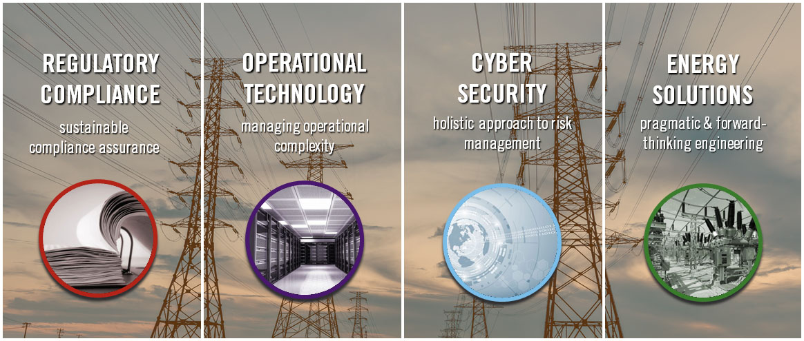
AESI’s Service Offerings
Management Consulting
Training
Notes:
AESI has four practice areas:
Regulatory Compliance services
Operational Technology services
Cyber Security services
Energy Solutions services
Across all four practice areas we provide Management Consulting and Training services.
Our services are described in more detail on the following slides.

Slide 4

Management Consulting Services
OPERATIONAL RISK ASSSESSMENTS
RISK MANAGEMENT / GOVERNANCE PROCESSES
CYBER / PHYSICAL SECURITY PROGRAM DEVELOPMENT
ADVISORY SERVICES
Notes:
AESI provides management consulting services in the following four categories:
1)- Operational Risk Assessments
AESI assesses our clients’ operations identifying risks and gaps to best practices. Risks are categorized and prioritized for maximum effectiveness.
2)- Risk Management / Governance Processes
AESI assists its clients with risk management in developing operational risk management programs complete with risk registers and process maps. AESI ties the risk management elements together with a governance structure and processes.
3)- Cyber / Physical Security Program Development
AESI develops security programs for large, mid-sized and small entities. For those entities that have already developed a program AESI assists those entities to optimize their program,.
AESI’s approach is risk-based and founded on authoritative standards such as the NIST Cybersecurity Framework, NERC CIP, US Department of Energy Cyber Capability Maturity Model (C2M2), and Generally Accepted Privacy Principles (GAPP).
Our deliverables include a detailed current state assessment, recommendations, a long-term roadmap and guidance. Many of our clients ask us to assist in implementing the recommendations and roadmap.
4)- Advisory Services
AESI provides value-added advisory services in areas such as expert witness, due diligence assistance, and organizational planning.

Slide 5




Management Consulting – Value to our Clients
OPERATIONAL RISK ASSESSMENTS
  Trust AESI to identify, assess and prioritize your critical operational risks.
RISK MANAGEMENT / GOVERNANCE PROCESSES
  Develop and implement standards-based risk management processes - addressing risks enterprise-wide.
CYBER / PHYSICAL SECURITY PROGRAM DEVELOPMENT
  Develop and implement a security program to address risks, all while increasing resiliency and security maturity.
ADVISORY SERVICES
  AESI – a trusted advisor for your strategic and critical initiatives.
Notes:
The value for our clients from our management consulting services emanates from our deep industry knowledge and our ability to provide guidance for effective operations and programs. We augment the guidance with implementation assistance as requested by our clients.
Our management consulting services are based on authorative industry standards which provides our clients with extensive support resources and sustainability.
Our risk management services identify, prioritize, and quantify the risks.
Our cyber / physical security services culminate in a pragmatic and effective program balanced across the “three legs of the security stool”, i.e. people, governance & process, technology.
Our clients view us as a trusted and strategic advisor, and we work hard to keep that status. We provide no charge quarterly checkpoints with our clients which provides our client the ability to ask questions and to obtain industry updates and guidance from us.

Slide 6
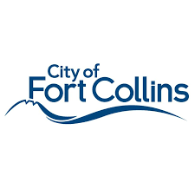





Select Management Consulting Clients

Slide 7

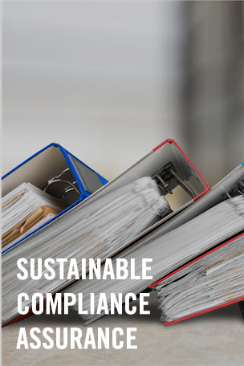
Regulatory Compliance
COMPLIANCE ASSURANCE & ASSESSMENT
“TURN KEY” COMPLIANCE IMPLEMENTATION
COMPLIANCE ADVISORY
FULL-SERVICE NERC COMPLIANCE MANAGEMENT
Notes:
<Steve>

Slide 8


Regulatory Compliance – Value to our Clients
COMPLIANCE ASSURANCE & ASSESSMENT
  Achieve real time compliance awareness – are you audit ready? We can help you get there.
“TURN KEY” COMPLIANCE IMPLEMENTATION
  “Day 1 and Beyond” Compliance - AESI maps the course and is there to guide your organization to compliance readiness.
COMPLIANCE ADVISORY
  Whether a simple question, interpretation or a complex response to a regulator, AESI provides real-time support for your compliance team when and where needed.
FULL-SERVICE NERC COMPLIANCE MANAGEMENT
  Depend on AESI to manage NERC Compliance readiness - while you focus on day-to-day operations.
Notes:
<Steve>

Slide 9









Select Regulatory Compliance Clients

Slide 10

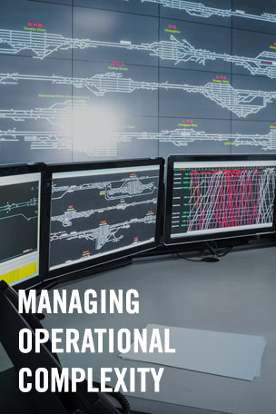
Operational Technology
IT/OT ASSESSMENTS & STRATEGY
INFRASTRUCTURE PLANNING, DESIGN, AND VENDOR SELECTION
SOLUTION IMPLEMENTATION & INTEGRATION
SUSTAINMENT AND MAINTENANCE
Notes:
<Ed>

Slide 11
Operational Technology – Value to our Clients
IT/OT ASSESSMENTS AND STRATEGY
  Through analyzing your current operations, future needs, and industry trends, AESI creates achievable leading edge IT/OT ecosystem strategies and roadmaps for operational excellence.
OT INFRASTRUCTURE PLANNING, DESIGN, AND VENDOR/SOLUTION SELECTION
  We convert strategies and roadmaps to secure scalable system designs and optimized implementation plans by assisting with the selection of vendors and solutions to meet your current and future needs.
OT SOLUTION IMPLEMENTATION AND INTEGRATION
  AESI manages and/or executes the installation, configuration, integration, testing and cutover of the entire OT solution stack; including network/communications, hardware, and software.
OT SUSTAINMENT AND MAINTENANCE
  AESI will augment your resources to ensure your OT is well maintained, up to date, and always meeting your organization’s needs - through upgrades & patch management, configuration & integration services, and monitoring & tuning.
Notes:
<Ed>

Slide 12










Select Operational Technology Clients

Slide 13

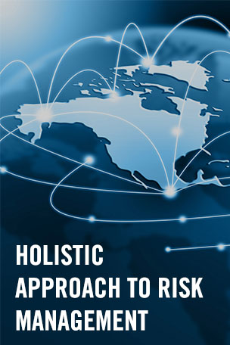
Cyber Security
RISK ASSESSMENTS
ADVISORY SERVICES
PROGRAM IMPLEMENTATION
MANAGED SERVICES
Notes:
<Ed>

Slide 14
Cyber Security – Value to our Clients
SECURITY RISK ASSESSMENTS
  AESI assesses your cyber & physical security and privacy risk, posture & program maturity, using standards and industry best practices, whether vulnerability assessments, penetration testing or a rigorous policy/process review.
ADVISORY SERVICES
  Obtain advice from AESI’s industry leading cyber security experts to enhance your cyber security programs. From roadmaps & business cases, to detailed network & system architectures - we have you covered!
PROGRAM IMPLEMENTATION
  Build and deploy world class cyber security programs, optimized for your organization, including policy and procedure development, tool implementation, and staff training.
MANAGED SERVICES
  Supplement your staff with AESI’s managed services – including cyber security monitoring and remediation support, patch management, incident response, and CISO as a service.
Notes:
<Ed>

Slide 15









Select Cyber Security Clients

Slide 16
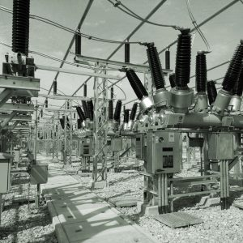

Energy Solutions
ENERGY ADVISORY
ENERGY MANAGEMENT
OPERATIONS, FINANCIAL & RELIABILITY PLANNING
ENGINEERING
MICROGRIDS / DISTRIBUTED ENERGY RESOURCES PLANNING & IMPLEMENTATION
Notes:
<Nimish>

Slide 17



Energy Solutions – Value to our Clients
ENERGY ADVISORY
  An understanding of all aspects of utility operations allows proven and pragmatic energy advisory.
ENERGY MANAGEMENT
  AESI’s equips its clients with effectively designed solutions to manage the fast-evolving power sector with risk management.
OPERATIONS, FINANCIAL & RELIABILITY PLANNING
  In depth experience developing utility plans to optimize and manage all facets of operations - from asset management to capital planning & execution.
ENGINEERING
  Large scale project experience including technical studies, planning, construction & commissioning oversight
MICROGRIDS / DISTRIBUTED ENERGY RESOURCES PLANNING & IMPLEMENTATION
  Simplifying the complexities of Microgrid & DERs planning - ensuring efficient design and implementation
Notes:
<Nimish>

Slide 18









Select Energy Solutions Clients

Slide 19

Training
For All Skill Levels – introductory, intermediate and advanced
Flexible Delivery to enable customized training sessions.
Subject Matter Experts share a wealth of knowledge on successes and lessons learned in the industry.
Cost-Effective Approach to strike a balance between fundamental concepts and best practices relevant to each individual utility.
Notes:
<Loreto>
AESI has provided value-added training for many years.
AESI’s training caters to all skills levels – introductory, intermediate and advanced.
Our training ranges from technical training through to governance including Board of Directors / Executive Team training.
Our training raises the knowledge level of your staff enabling more efficient, secure and compliant operations.
<add blurb on new learning platform when available>

Slide 20


Slide 21
Thank You !
Doug Westlund
Senior Vice President, Principal Consultant
AESI
dougw@aesi-inc.com
416.997.8833

