Slide 1
Public Power Cybersecurity Management Program
Branndon Kelley
Hometown Connections, Inc.
September 2022

Slide 2
Cybersecurity Program
Assess
  Assess current state (baseline)
Mitigate
  Implementing Cybersecurity improvements and remediating issues found during assessments
Monitor & Manage
  Ongoing monitoring of Cyber threats to infrastructure and vulnerabilities
Assess
Mitigate
Monitor & Manage

Slide 3
Assessment
Assess
Mitigate
Monitor & Manage

Slide 4
Cybersecurity Assessment Overview
Each Assessment Includes
  Internal & External Vulnerability Scans
  Firewall Configuration Review
  IT Cybersecurity Policies & Procedures Review
  Center For Internet Security (CIS) Controls and Cybersecurity Capability Maturity Model (C2M2) Assessments
  Phishing Exercise
  Incident Response Tabletop Exercise
  Final Report with Findings, Recommendations, Roadmap & Budget
  Executive Presentation to Leadership and/or Council

Slide 5
Cybersecurity Assessment Phases
Phase One – Kickoff & Data Collection
Phase Two – Remote Work Activities
Phase Three – Data Analysis & Final Report/Presentation

Slide 6
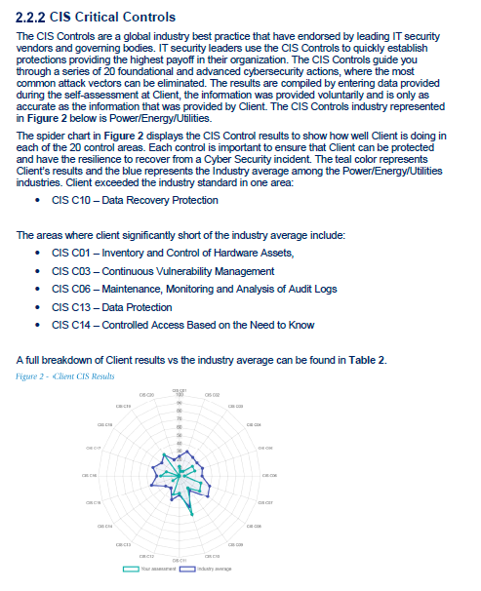
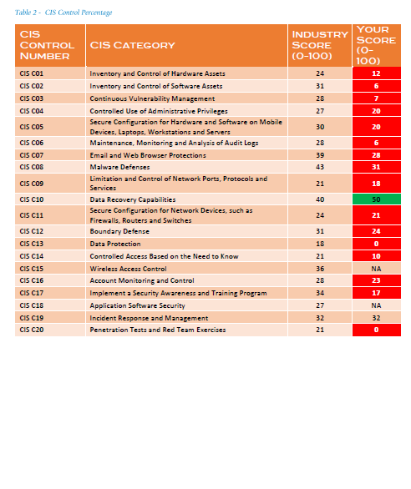
Cybersecurity Assessment Report

Slide 7
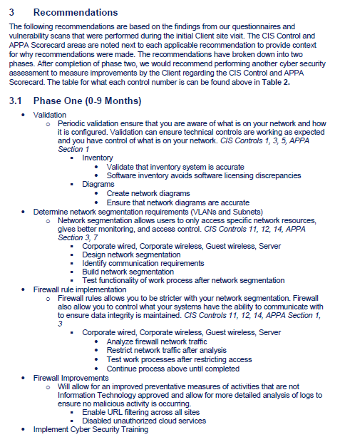
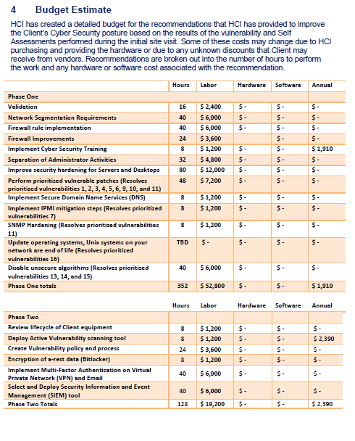
Cybersecurity Assessment Report

Slide 8
Cybersecurity Assessment Value
Upon completion of the assessment, a utility will have:
  An understanding of the utility’s cybersecurity maturity benchmarked with other public power utilities.
  A report on how well best practice guidelines are currently deployed within the utility’s network(s) as it relates to the CIS controls and C2M2 Framework.
  A list of vulnerabilities and critical systems that are exposed.
  A better understanding of Cyber Incident response and a playbook for building / improving upon this important area.
  A short-term (0-9 months) and longer-term (9-18 months) roadmap for remediation priorities along with budget costs.
  Results from phishing/cyber awareness exercise.
  An understanding of the current security and recoverability processes along with recommendations for areas of improvement.
  A report and presentation that can be shared with leadership summarizing all the above items.

Slide 9
Reasons why a municipality / utility would do this…
Don’t know where to start in fixing Cybersecurity. Need to know how much budget to allocate and/or in what order to address things.
Challenged with getting leadership onboard to allocate budget and address issues. Need an independent expert to validate the need and approach.
Been a while since last assessment by a third party. Want to get a new baseline to see how we are doing and where to go next.
  Want to make sure we are spending in the right areas to maximize our Cybersecurity return on investment.
To support compliance efforts and certifications
  Examples: NIST, NERC-CIP, Public Power RP3 Certification
Maintain a good credit rating (Moody's) and/or eligibility and lower premiums for Cyber Insurance

Slide 10
Obtaining a quote
Complete short data questionnaire / scoping call
Sized as small / medium or large based on:
  # of firewalls & internet connections.
  # network switches and network segments.
  # of endpoints (computers, servers, printers).
  # of business applications (Billing, GIS, SCADA, OMS, WOMS).
  # of third party IT vendors in use.
  # of cybersecurity systems in place (picked from a list).
  # of written IT policies.
  Any custom application development done in house?

Slide 11
Mitigate
Assess
Mitigate
Monitor & Manage

Slide 12
Mitigation Examples
Helping a Michigan based municipality design and implement a more secure network architecture.
Helping municipalities implement additional controls, procedures and better cybersecurity technologies.
Helping with vulnerability remediation and verification.
Additionally, mitigating Cyber risk also involves Cybersecurity Training…

Slide 13
Cybersecurity 101 Workshop

Slide 14
Cybersecurity 101 Workshop
Duration: 6 Hours
Target Audience: Utility Staff, General Managers, Billing Staff, IT
Morning Sessions:
  The Overall Threat Landscape
  Ransomware and Public Power
  Cyber Insurance Requirements
  Cybersecurity: Operational Technology (OT) vs Information Technology (IT)
  Building an Effective Cybersecurity Awareness Program

Slide 15
Cybersecurity 101 Workshop
Afternoon Sessions:
  Threat Awareness Information: What’s available? What should you subscribe to?
  Incident Response Exercise
  Building and implementing an Incident Response Plan
  Vulnerability Management: What you should ask your IT staff
  Closing Session: Tying it all together / Recap

Slide 16
Cybersecurity 101 Workshop - Testimonials
“The cybersecurity workshop facilitated by Hometown Connections served as a great reminder that we need to stay vigilant in the everchanging digital world. The speaker’s wealth of knowledge helped our organization become aware of cyber threats and assisted us in creating a game plan so that we can remain proactive and prepared”
– Bryan Brackemyre, Indiana Municipal Power Agency
“I’ve been to several cybersecurity training sessions, but after Hometown Connection’s cybersecurity class, everything finally clicked for me. Of all the trainings I go to, cybersecurity is my number one priority, and this workshop provided amazing information and resources for our community”
– Shari Johnson, Town of Advance

Slide 17
Monitor & Manage
Assess
Mitigate
Monitor & Manage

Slide 18
Cybersecurity Program - Future
Phase I and II of program focus is on assessment and mitigation.
Upcoming offering will include Mitigation and Monitoring and Cybersecurity Management
  Cybersecurity Monitoring
  Vulnerability Management

Slide 19
Monitor & Manage – Solution Components
Managed Detection and Response
  Provides 24×7 monitoring of municipality networks, endpoints, and cloud environments and that can help detect, respond, and recover from cyber-attacks.
Vulnerability Management System
  A network and/or agent-based vulnerability scanning solution that has the capability to scan a municipality’s network and identify all unresolved vulnerabilities.
  Solution should include high level reports that show vulnerabilities ranked using the Common Vulnerability Scoring System (CVSS).
Consolidated Dashboard / View for HCI (Optional)
  In addition to each customer having their own dashboard view, a key component of this solution will be to allow HCI to be able to have a consolidated dashboard showing information for each of their utility members
  This would allow HCI to provide added value, assist with opening tickets, helping members with more complex security investigations and issues, hold vulnerability remediation meetings, and provide other cyber assistance services as needed.

Slide 20
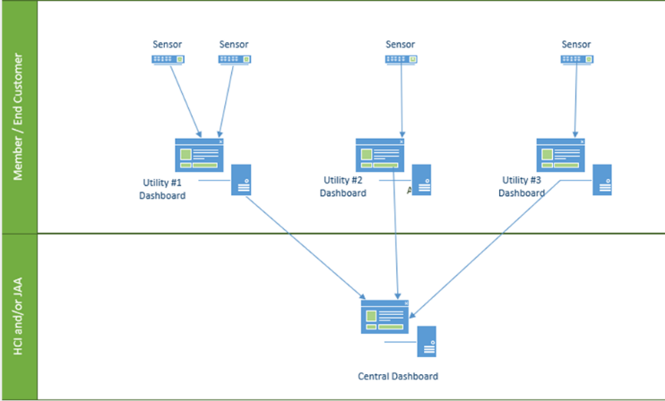
Monitor & Manage – Proposed Architecture
Municipality Environments
  Each environment would be accessible to only that municipality / utility.
  Each municipality / utility would only have access to their data.
Central Dashboard
  Would display data and alerts from all utility environments in a segmented view.
  Aggregate rollups for displays and reporting.

Slide 21
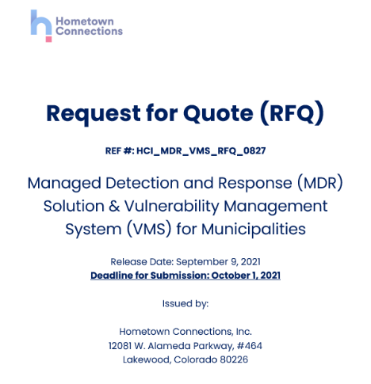
Request For Quote
AMP, via Hometown Connections, issued a Request For Quote to 12 separate vendors providing services in this space.
  In addition to the above the Request For Quote was posted on the Hometown Connections website sent to APPA for them to post as well
The Request For Quote had 22 total requirements listed.
In addition to the requirements, we asked the vendor to address project management, delivery, onboarding, and ongoing support.
Pricing was requested via a standardized pricing template so vendors could be compared apples to apples.

Slide 22
Request For Quote
Timeline
RFQ Released
Sent to 12 Vendors and posted on Hometown Connections website. Also sent to APPA for Posting.
17 Sep.
Deadline for Questions and Clarifications
1 Oct.
RFQ Submissions Due
Received 7 Response
4–8 Oct.
Evaluated initial responses. Selected vendors to demo.
11–19 Oct.
Held Demonstrations with 5 vendors.
20 Oct.
Evaluation Team met to discuss results
22 Nov.
Presented to HCI Executive Management Team

Slide 23
Request For Quote - Respondents
Sent RFQ (12)
AESI (Hometown Partner)
Alertlogic
Arctic Wolf
Arista
Brain Trace
Crowdstrike
IPKeys
Qualys
Rapid 7
Red Canary
SecureWorks
Sophos
AESI (Hometown Partner)
Alertlogic
Honeywell
IPKeys
Novacoast
Rapid 7
Sophos
RESPONDED (7)

Slide 24
Request For Quote – Finalist Recommendations
Two finalists identified
  Met the base requirements in RFQ
  Both are focused on providing services to municipalities.
  Best overall pricing of solutions evaluated.
Doing one pilot with each finalist.
  Both pilots in progress now with two municipalities...
    Delaware Municipality
    Michigan Municipality

Slide 25
Thank You

