Slide 1


Strategic Planning Services
Mark McCain
Executive Consultant/Strategic Planning

Slide 2
My Background: 35 Years at FMPA in Florida
Facilitated Strategic Plans for FMPA and Its Members
Retired from Florida Municipal Power Agency (FMPA) in February 2022 after 35 years with the power agency
Part of FMPA’s senior leadership team since 2006
Leadership responsibility at various times for Member Services, PR, Public Affairs, HR, Administrative Services
Facilitated strategic plans for FMPA and its members

Slide 3




Start with a Shared Understanding of Terms
Vision | Image of the future we seek to create. If successful at achieving the Mission, this is what the future looks like.
Mission | A statement of the overall purpose of an organization. It describes what the organization does, for whom it does it, and what are the benefit.
Values | General guidelines that set the foundation for how an organization operates.
Goals | Broad, long-term aims that define accomplishment of the Mission. Goals can be external or internal.
Strategies | Broad activities required to achieve a Goal.
Action Plans | Specific steps to be taken, by whom and by when, to implement a Strategy.
Definitions of Common Strategic Planning Terms

Slide 4
Strategic Planning Can Vary Based on Utility
Four Phases of a Typical Planning Process
Brainstorm
Rank
Shortlist
Decide
Staff brainstorms potential Goals and Strategies in an online survey and then meets to refine them
Governing board and staff rank potential Goals and Strategies in an online survey
Staff creates a PowerPoint with information and a shortlist of key Strategies to achieve Goals
With input from staff, governing board decided on Mission, Vision, Values, Goals and Strategies
10 Weeks Out
7 Weeks Out
4 Weeks Out
Workshop Date

Slide 5
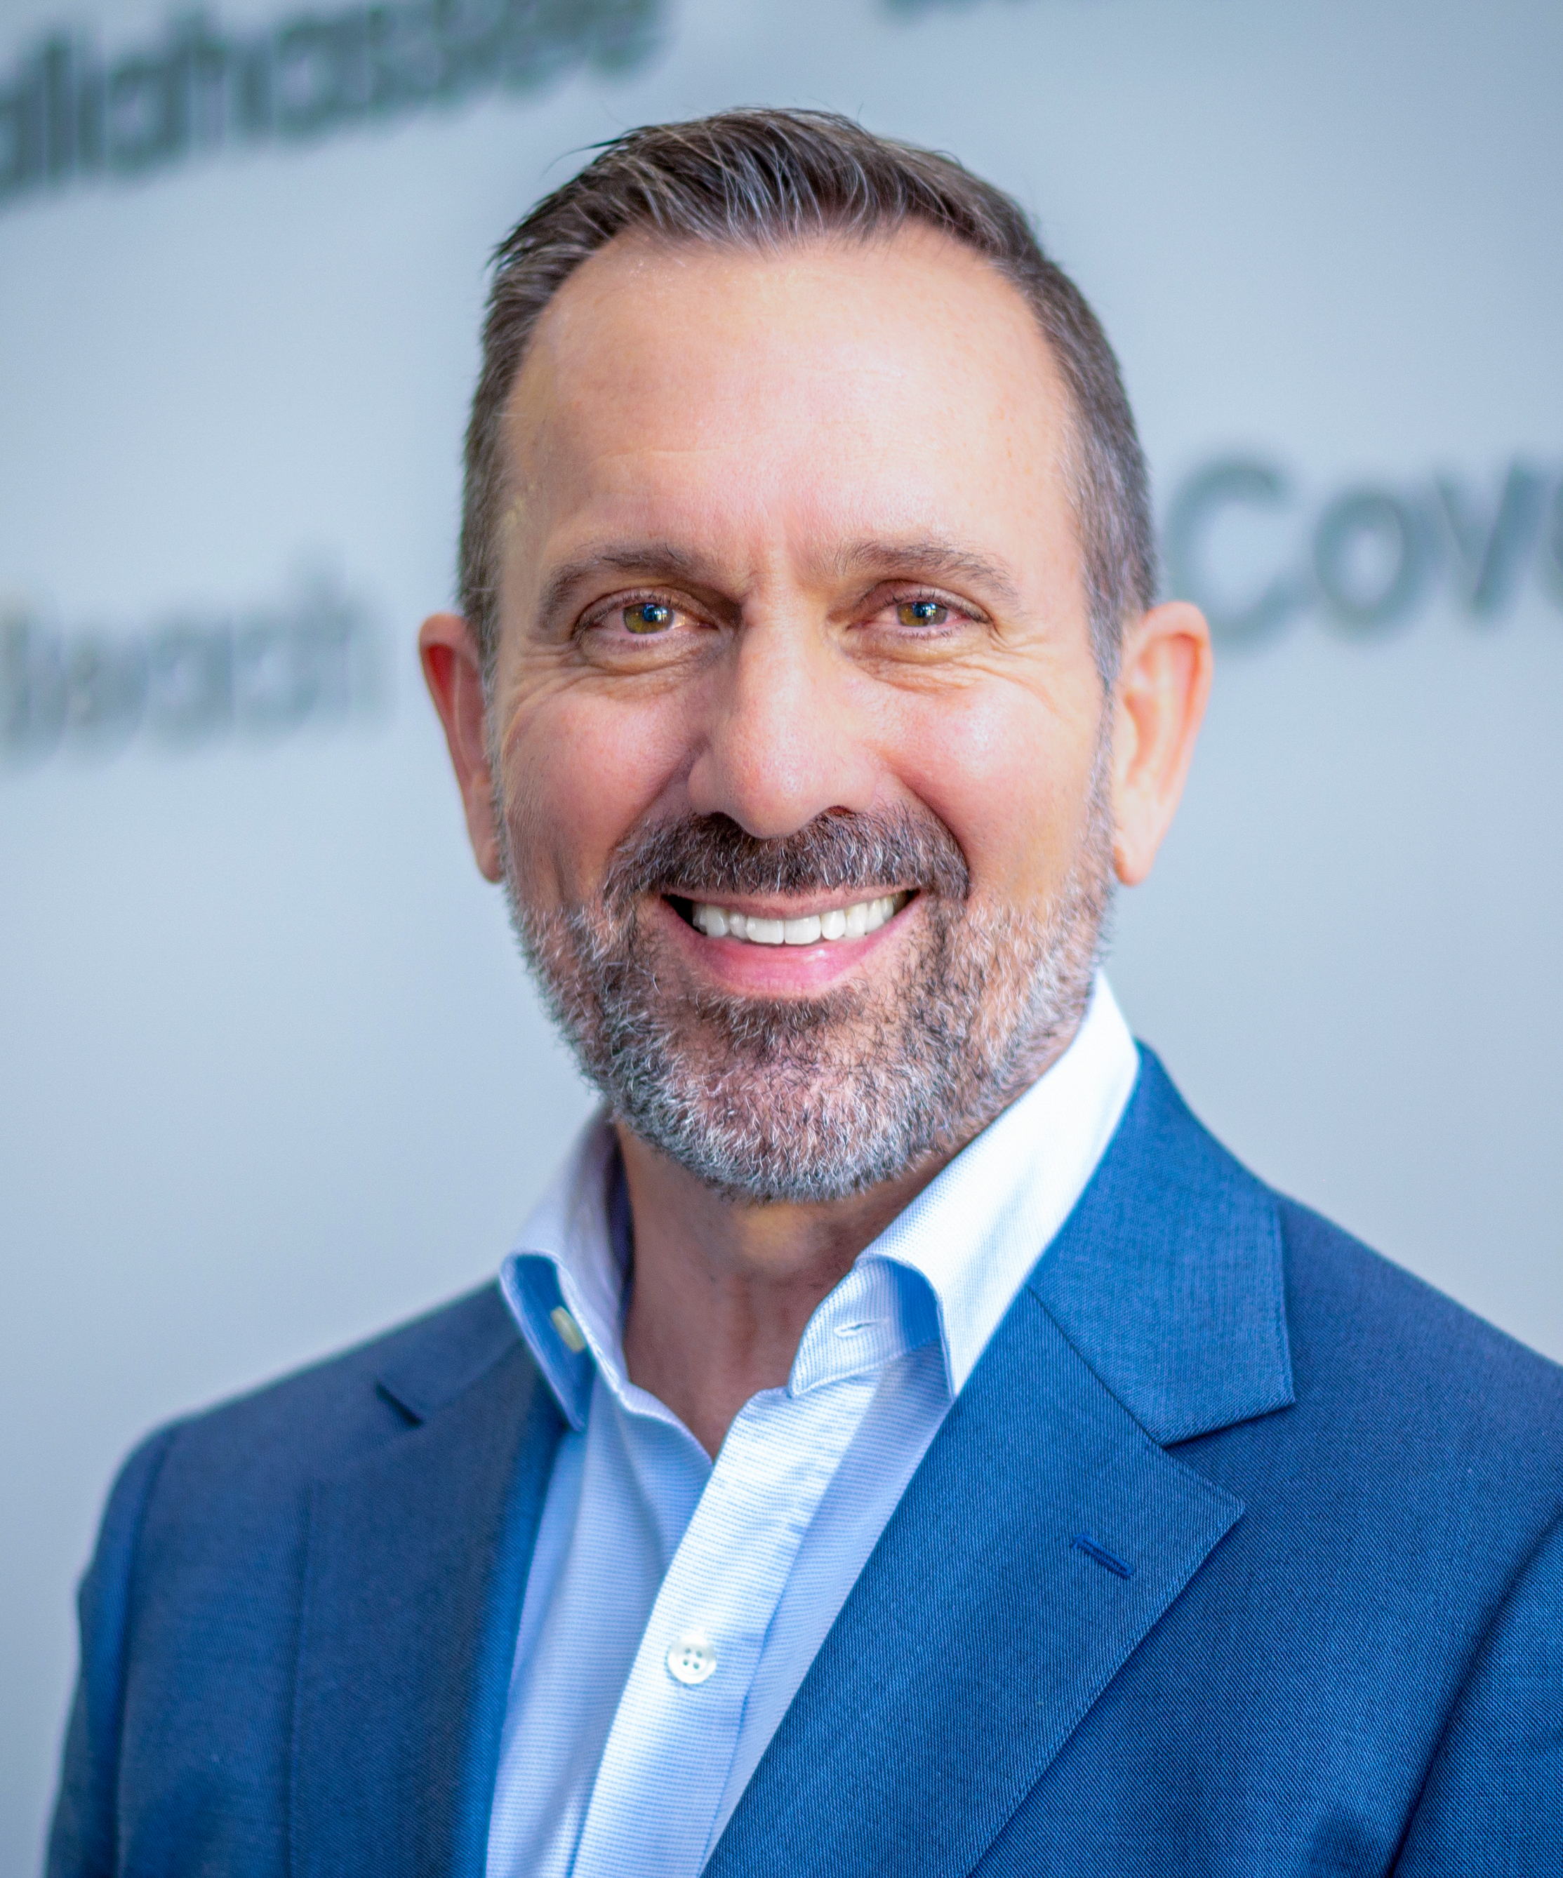


Contact Information
Mark McCain
Executive Consultant/Strategic Planning
Hometown Connections, Inc.
mmccain@hometownconnections.com
Mobile 407-951-3668

