Slide 1
Smart grid Solutions for public power
Louis Rosatone – Client services manager
James baker – Business Development, Emerging Services
Elizabeth massey – director, data dynamics

Slide 2
Economies of scale
25,000 MW of Generation
30,000 MW of
Peak Demand
>375 Bcf of NG/year
~75 Million MWh/year
~60 Public Power Clients
30,000 MW
$1.5B
Over $1.5B in gross
revenues annually
~200 employees
Offices in Jacksonville, FL
& Seattle, WA
Over 200,000 transactions per year
#1 in volume among community-owned entities
Trade across 40 states
#1

Slide 3
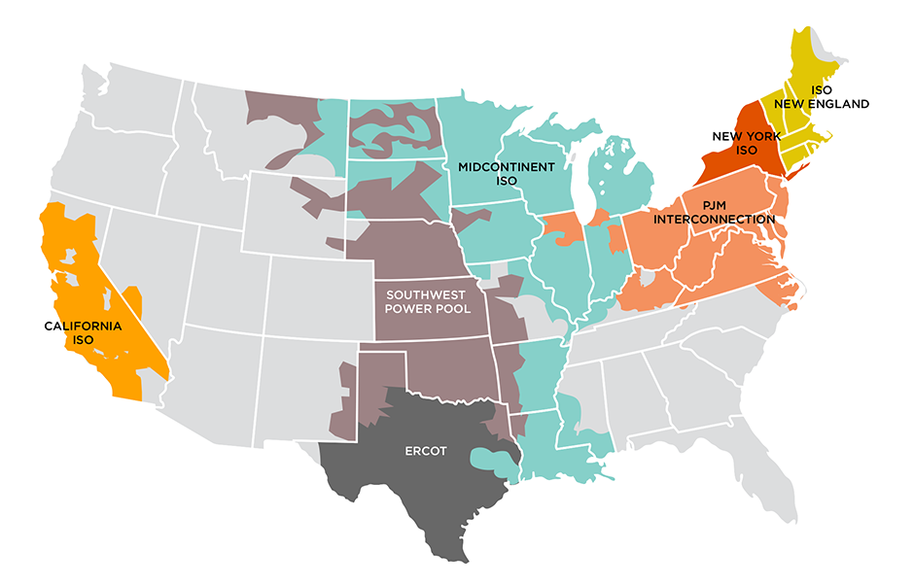
Coast-to-coast footprint

Slide 4
What does our mission mean to you?
Asset Optimization
Wholesale Power Markets
Portfolio Management
Advisory Services
Emerging Services

Slide 5
Emerging services

Slide 6
Beyond Meters to Cash
GIS Virtual Audit
Transformer Load Management
Customer Insights

Slide 7
Where are my meters?
Virtual GIS Analysis & Audit
Map vast majority of meters from the office
Trucks roll to the right place the first time
Improve outage visibility
Know what loads are on each transformer

Slide 8
Transformer load monitoring & management
Voltage data reveals transformer load
No additional sensors
Immediate view into both:
Overloaded transformers
Underloaded transformers

Slide 9
Customer insights

Slide 10
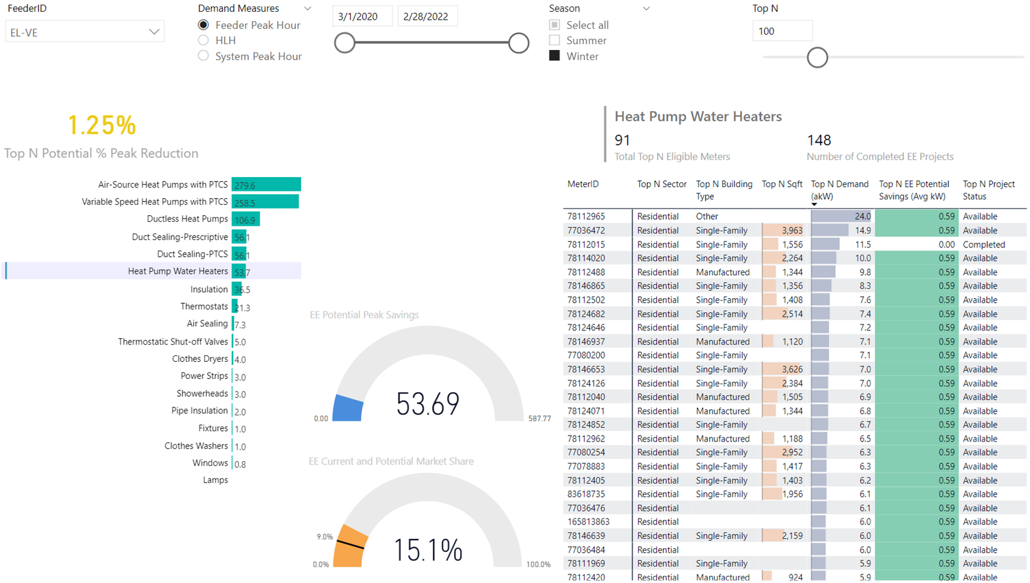
Customer insights
Segment by Building Type

Slide 11
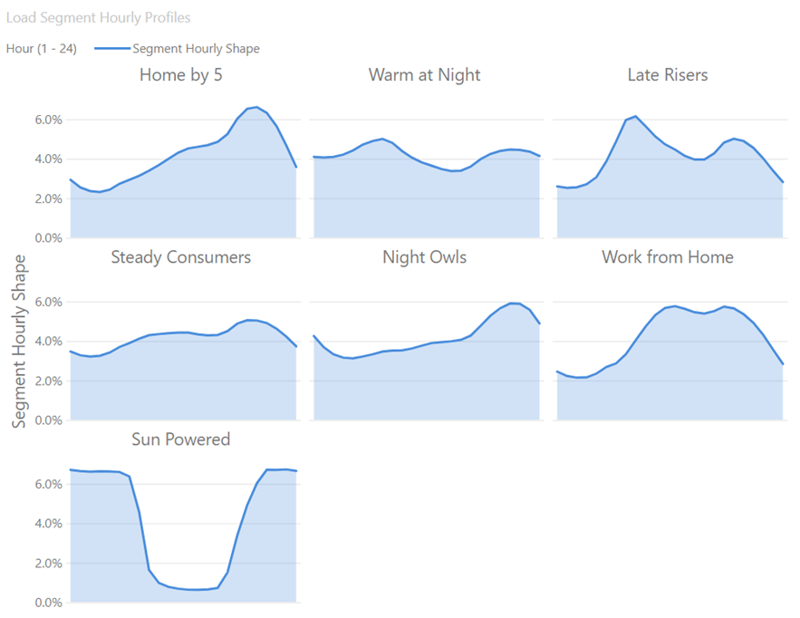
Customer insights
Segment by Customer Behavior
Demand response programs
Peak event communications
Time-of-Use rates
Energy efficiency programs
Education campaigns

Slide 12
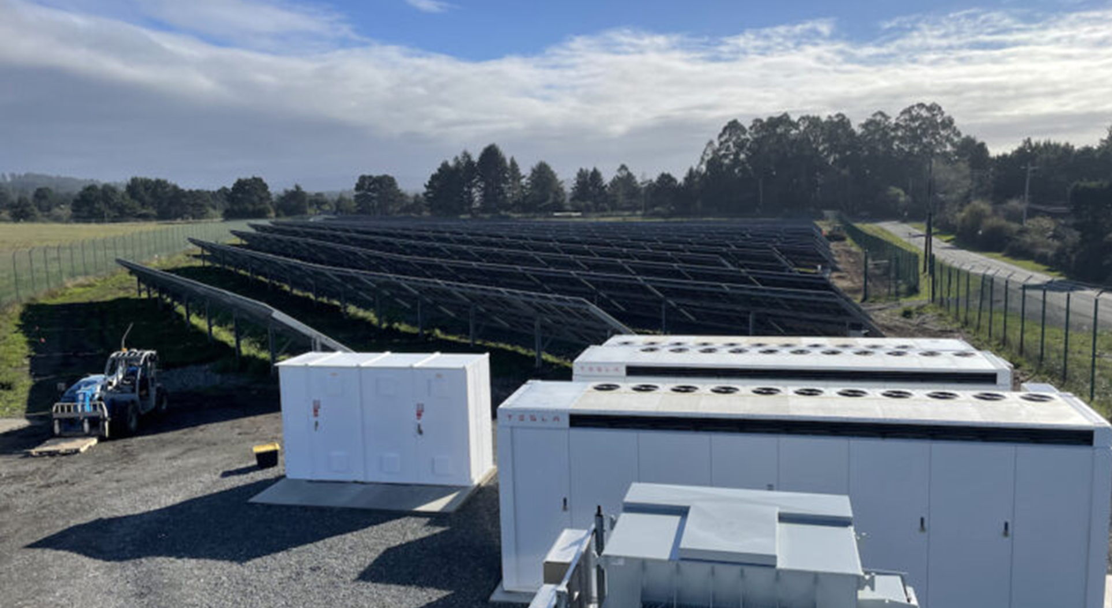
Solar + storage optimized & dispatched
Redwood Coast Airport Microgrid
Humboldt County, California

Slide 13
You have a choice
Tailored for a narrowly-defined objective
Low/no cap-ex
PPA
Prioritize among multiple possible objectives
Integrate with your other assets
Own & Optimize

Slide 14
Complexity abounds
LMP Uncertainty
Energy
Ancillary Services
Solar Production Uncertainty
Battery Constraints
Void Warranty?

Slide 15
sifting the multiple possible outcomes

Slide 16
Stay within the lines
2 on Power Balance
Grid charge/discharge = total system energy flow
Take efficiency losses out
1 on State of Charge
7 on Capacity Limits
Storage charge/discharge
SOC limits
Grid interconnection limits
AS available capacity based on energy offerings
1 on Cycling Limit
5 on Not Allowing Co-Charging
Make sure Reg-Down does not flip grid energy flow direction
3 on Status
4 on Bid Formulation
AND FINALLY
Upper and Lower Bounds for all decision variables

Slide 17
Working with tea… …Powered by stora & Data dynamics
25 Years Market Experience
Proven Edge in Asset Optimization
Strategic Partner for Public Power
Megawatts to Gigawatts
Integrative Approach
Holistic Vision

Slide 18
TO LEARN MORE
James Baker
Business Development, Emerging Services
904.360.1302
jwbaker@teainc.org

